Slide 1
Python, Tensorflow and Pytorch for DNN
曹辰捷，王艺楷，付彦伟

Slide 2
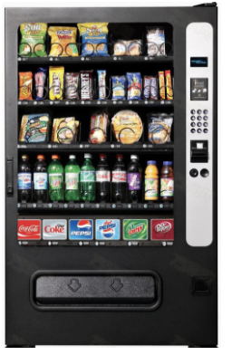
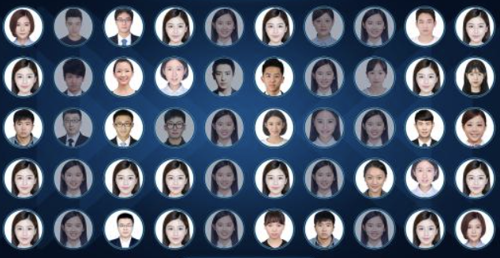

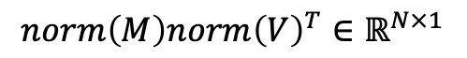
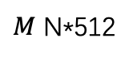
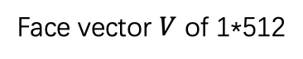
A deep learning example
Extract face features
Cosine comparison
Face vector $V$ of 1*512
$M$ N*512
$$norm\left(M\right)norm{\left(V\right)}^{T}∈ℝ^{N×1}$$

Slide 3
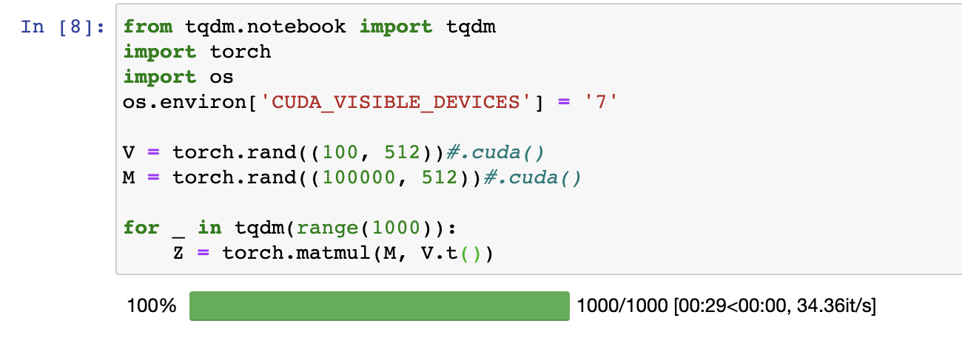
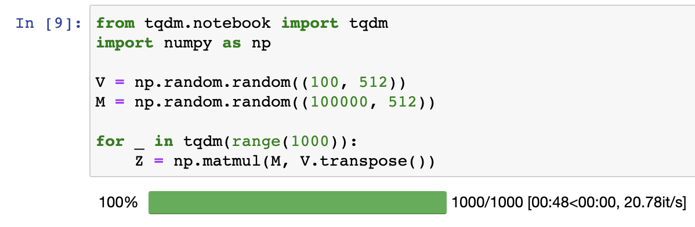
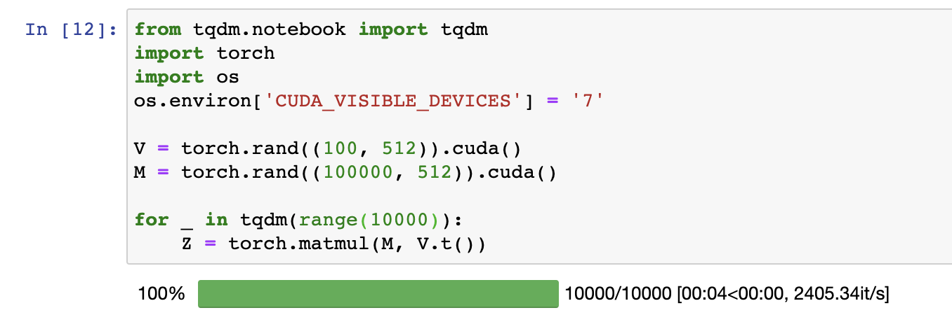
CPU Pytorch:
CPU Numpy:
GPU Pytorch:
10~20倍

Slide 4
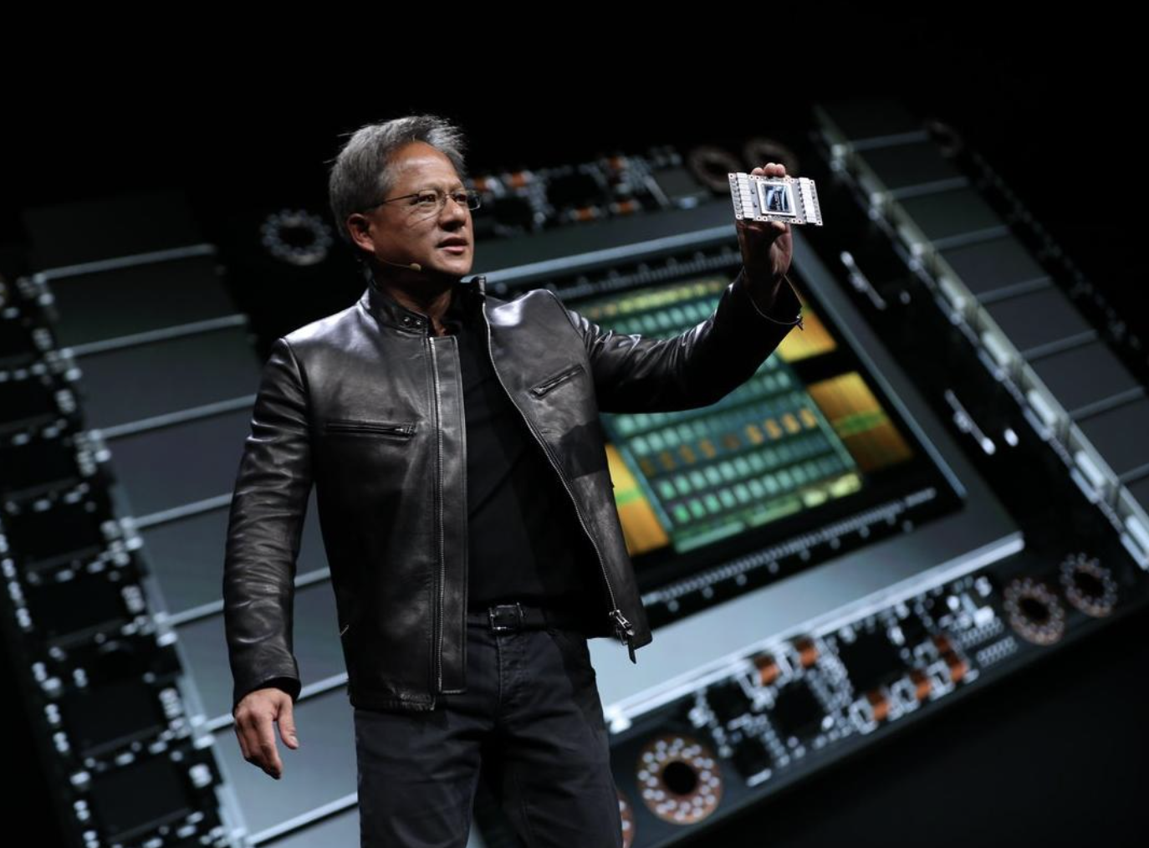
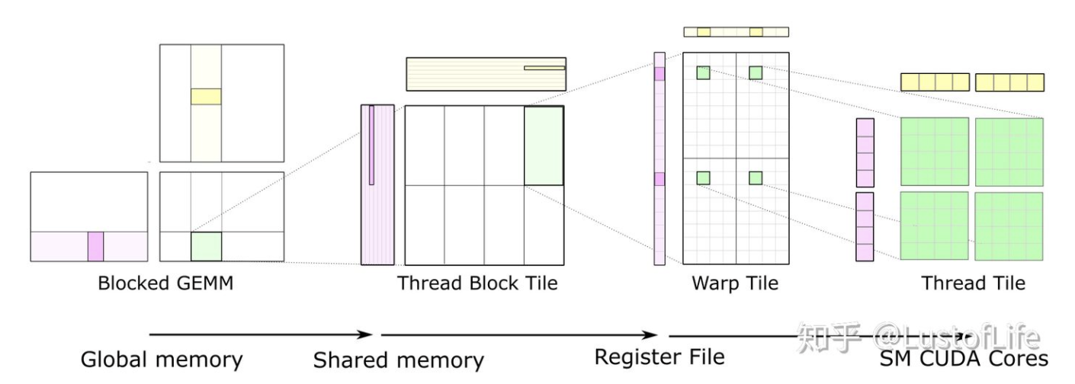
GPU parallel computation
https://developer.nvidia.com/
Notes:
DNN和GPU

Slide 5
What's TensorFlow?
Open source software library for numerical computation using data flow graphs
Originally developed by Google Brain Team to conduct machine learning and deep neural networks research
General enough to be applicable in a wide variety of other domains as well
2016.4.14 tensorflow=0.8
2016.6 tensorflow=0.9

Slide 6
Why TensorFlow
Python API
Portability: deploy computation to one or more CPUs or GPUs in a
desktop, server, or mobile device with a single API
Flexibility: from Raspberry Pi, Android, Windows, IOS, Linux to server farms
Visualization(TensorBoard)
Checkpoints(for managing experiments)
Large community
Awesome projects already using TensorFlow (google research)

Slide 7
What's a tensor
• An n-dimensional array • 0-d tensor: scalar(number) • 1-d tensor: vector • 2-d tensor: matrix • and so on

Slide 8
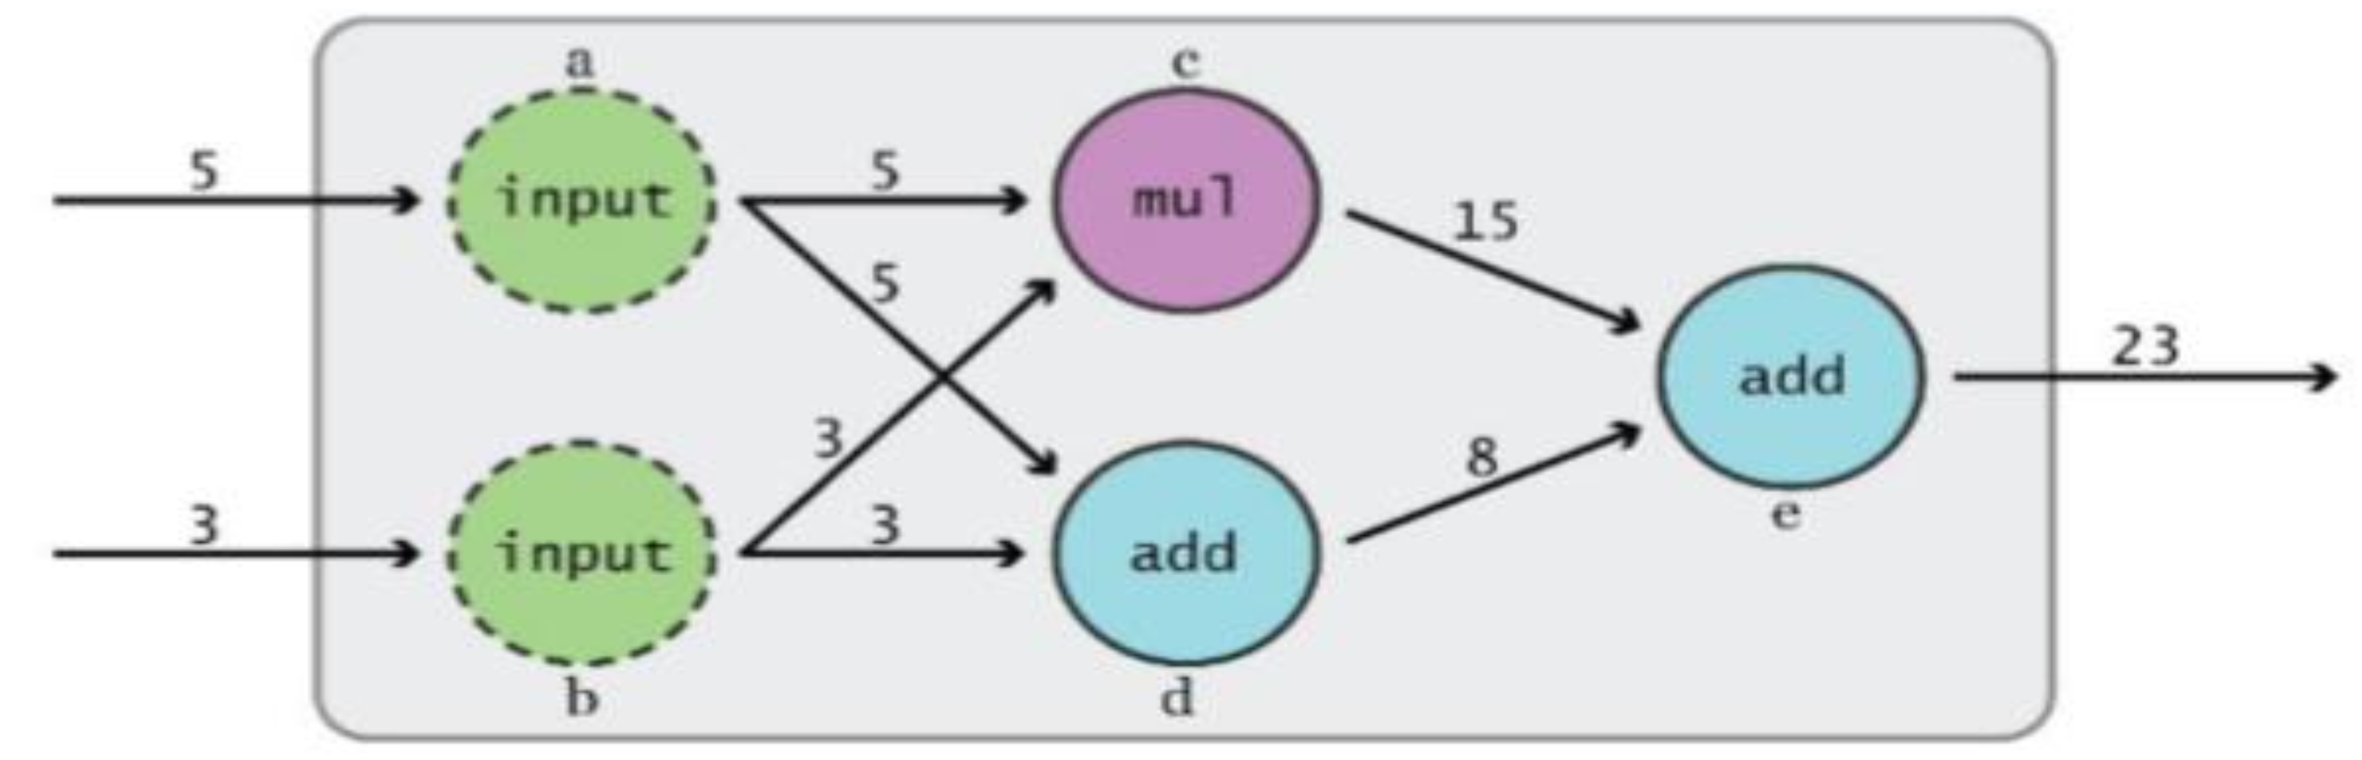
Data Flow Graphs
assemble a graph
use a session to execute operations in the graph
Notes:
这是tf1.X

Slide 9
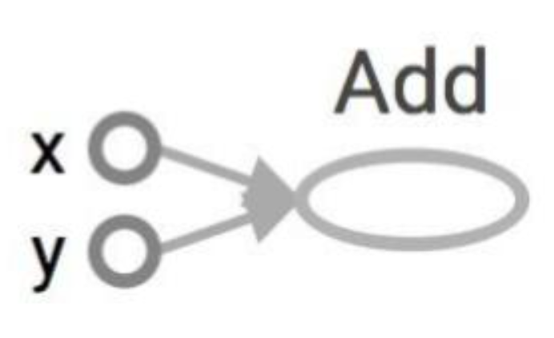
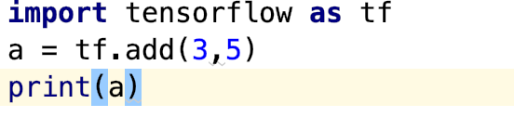
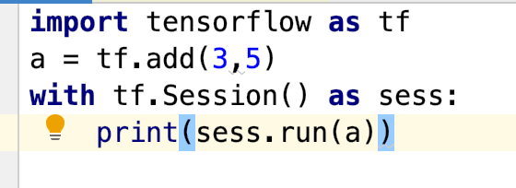
Data Flow Graphs
Tensor("Add:0", shape=(), dtype=int32)
8

Slide 10
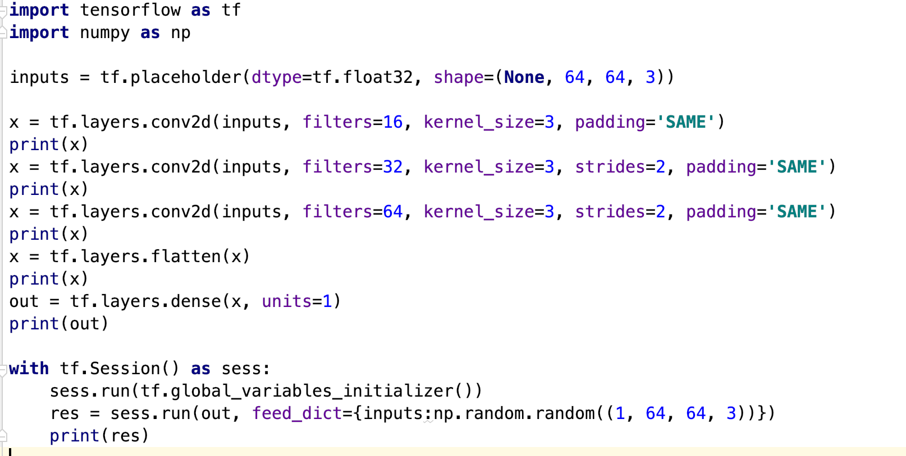
Create placeholders for inputs and labels
Tensor("conv2d/BiasAdd:0", shape=(?, 64, 64, 16), dtype=float32)
Tensor("conv2d_1/BiasAdd:0", shape=(?, 32, 32, 32), dtype=float32)
Tensor("conv2d_2/BiasAdd:0", shape=(?, 32, 32, 64), dtype=float32)
Tensor("flatten/Reshape:0", shape=(?, 65536), dtype=float32)
Tensor("dense/BiasAdd:0", shape=(?, 1), dtype=float32)
[[0.14791451]] (1*1)

Slide 11
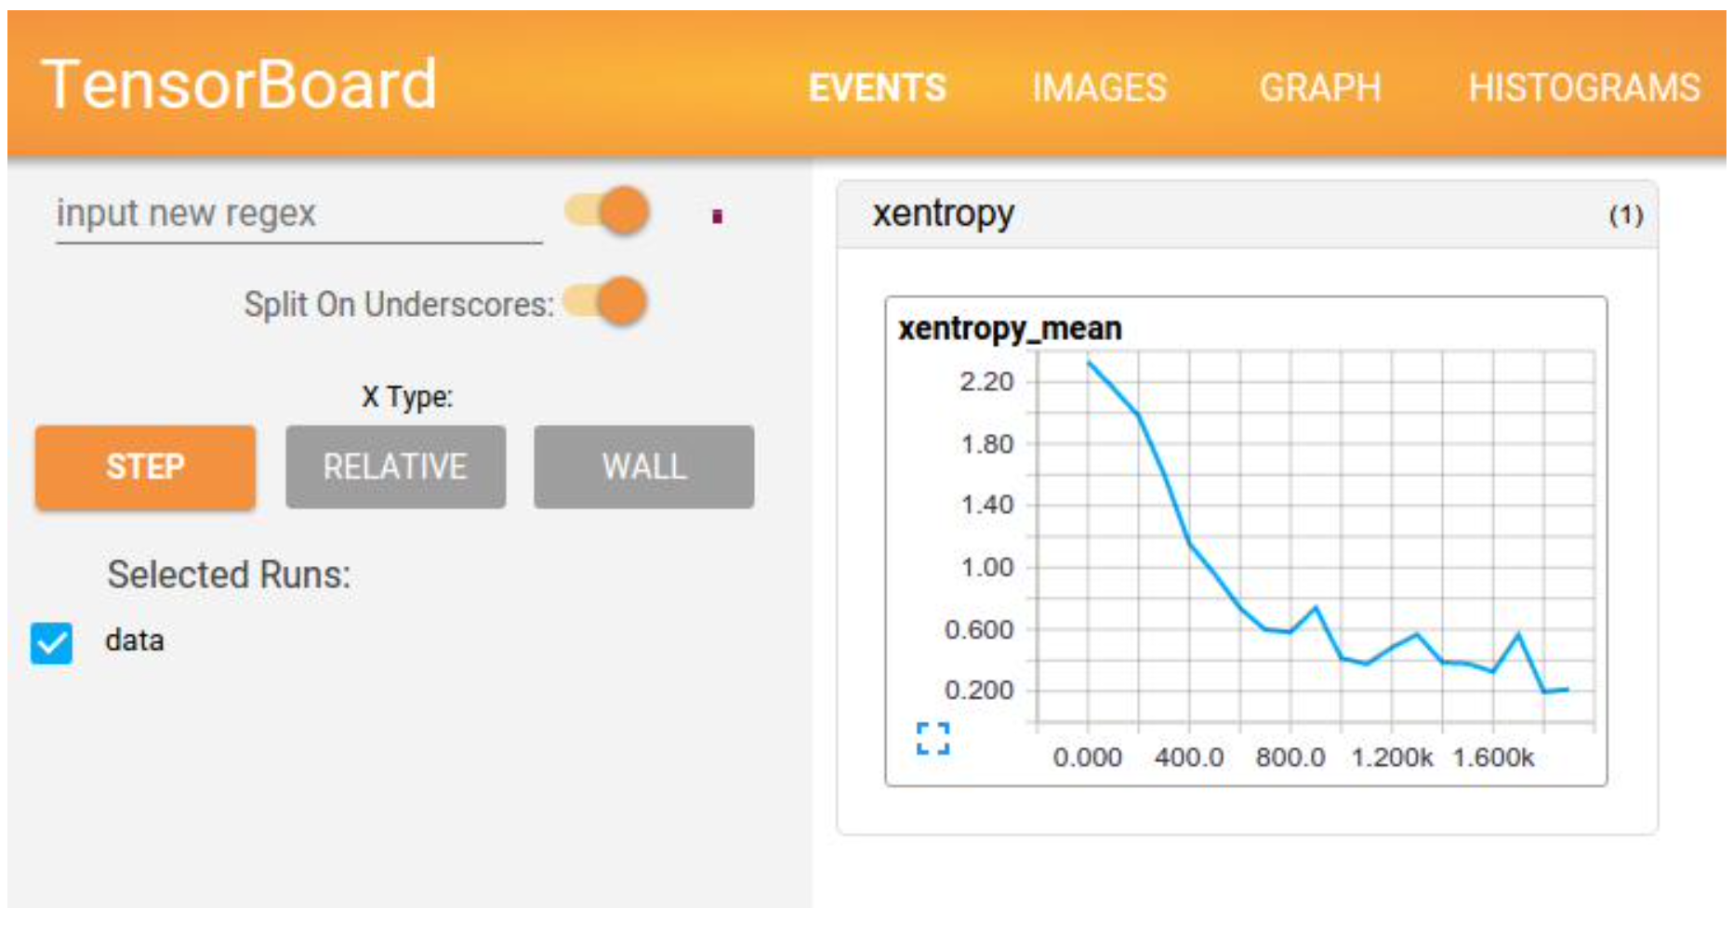
TensorBoard:Visulaizing Learning

Slide 12
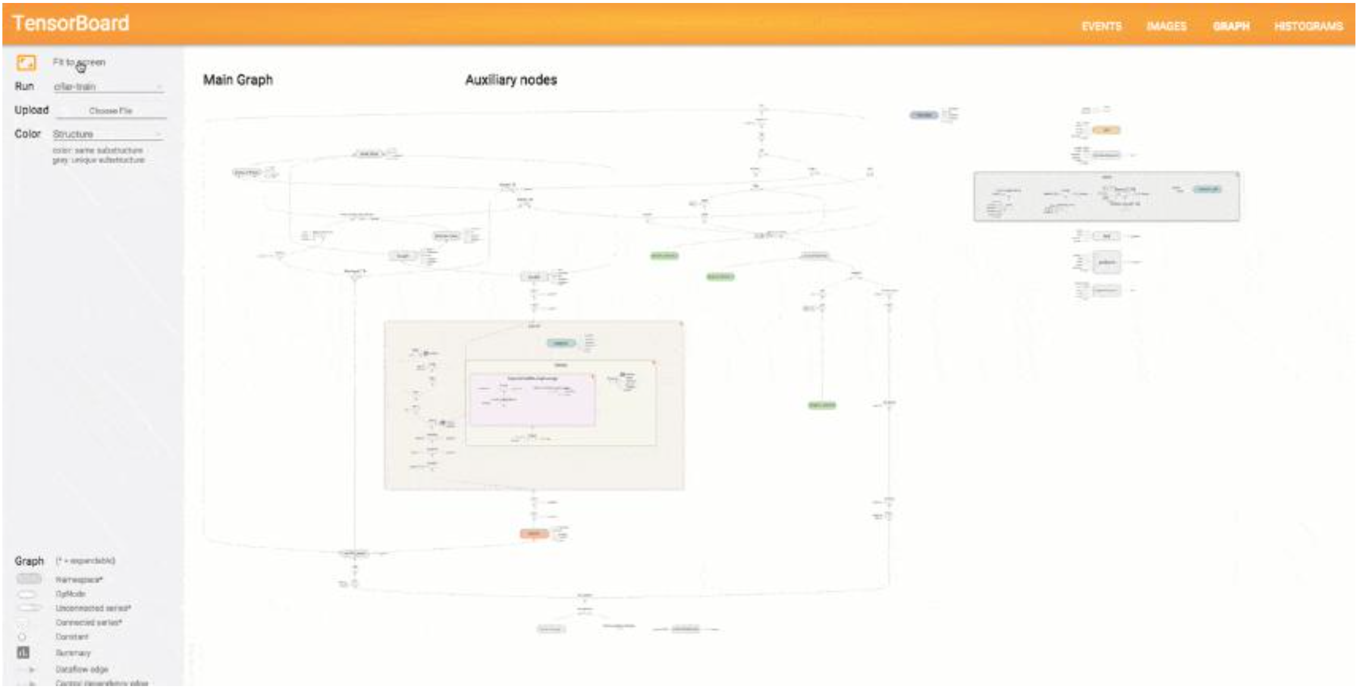
TensorBoard: Graph Visualization

Slide 13
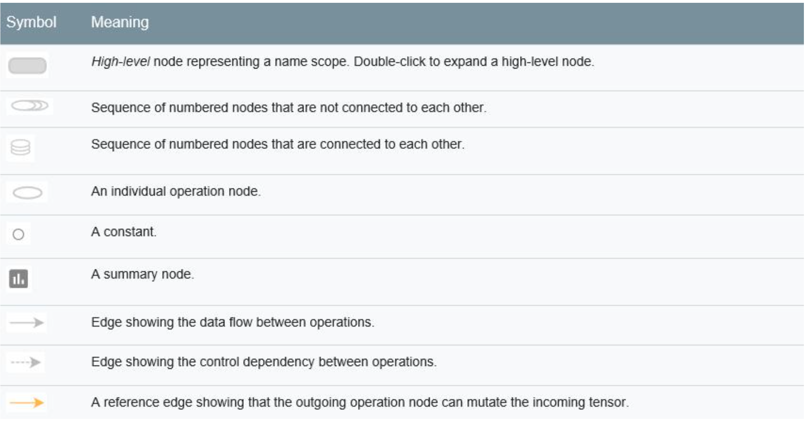
TensorBoard: Graph Visualization

Slide 14
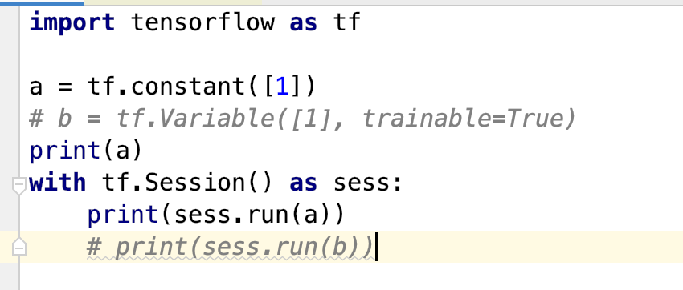
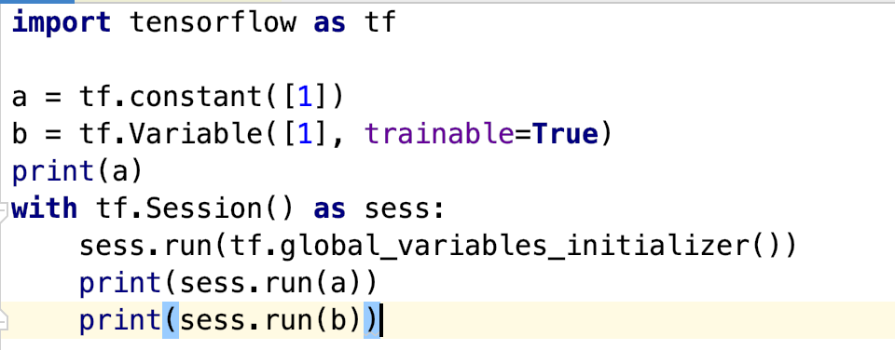
tf.constant() and tf.Variable()
• Constant values are stored in the graph definition
Sessions allocate memory to store variable values
[1]
[1]
[1]

Slide 15
tf.Variable() and tf.get_variable()
• tf.variable() 检测到命名冲突会自己处理
• tf.get_variable() 检测到命名冲突会报错
• 所以我们在需要共享变量的时候需要使用tf.get_variable()，其余 情况下，这两个的用法都是一样的。
How to build two models with one graph (train and eval) ?

Slide 16
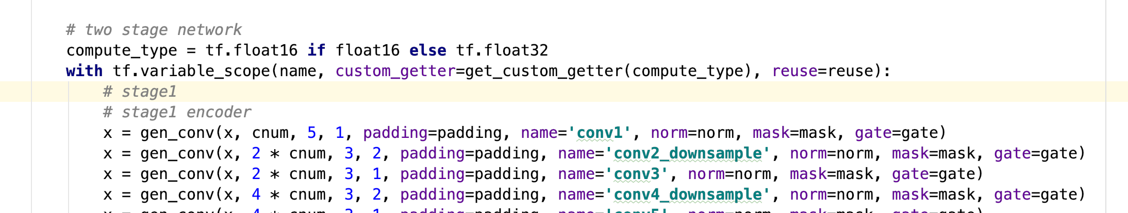
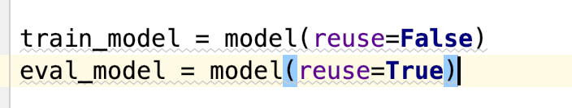
Multi model with one graph

Slide 17
Why we need more than one model?
Dropout
BatchNorm

Slide 18
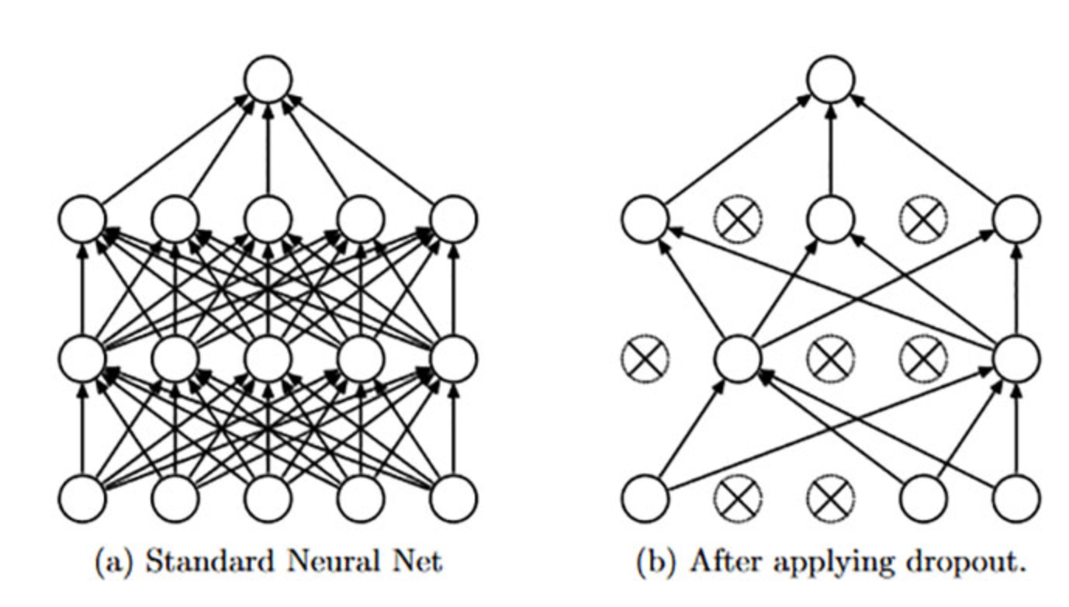
Dropout
Dropout for test?

Slide 19
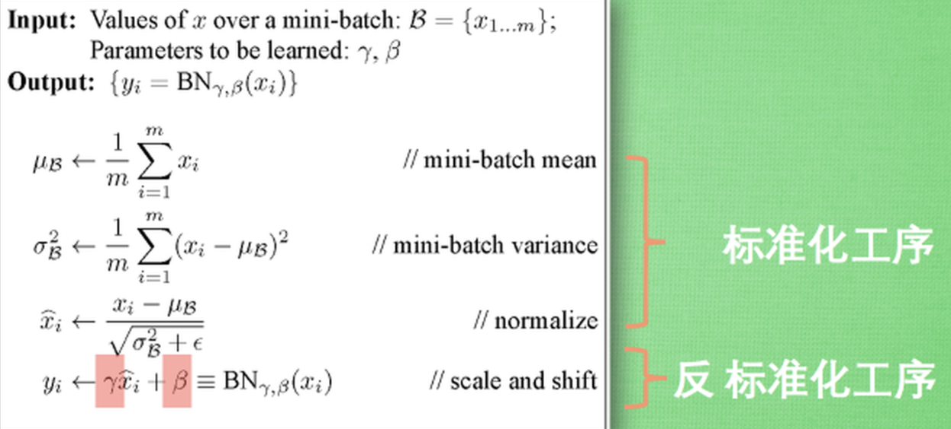
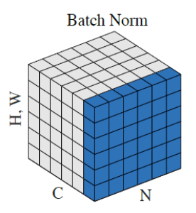
BN
BN: train with mean/var of each batch, but test with…?

Slide 20
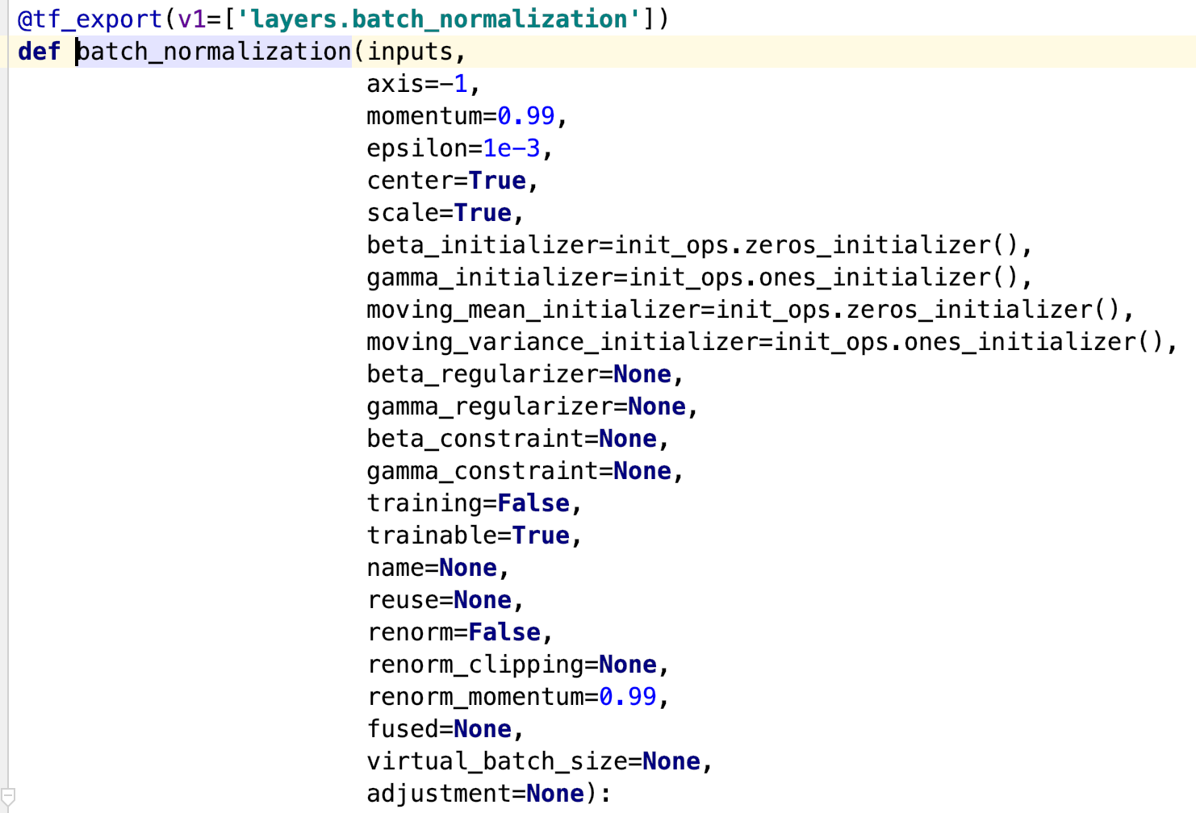

Slide 21
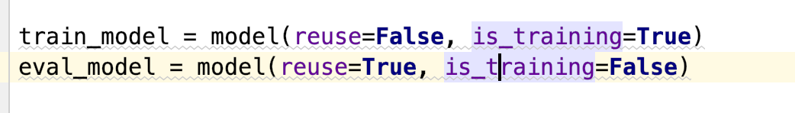
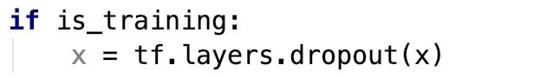
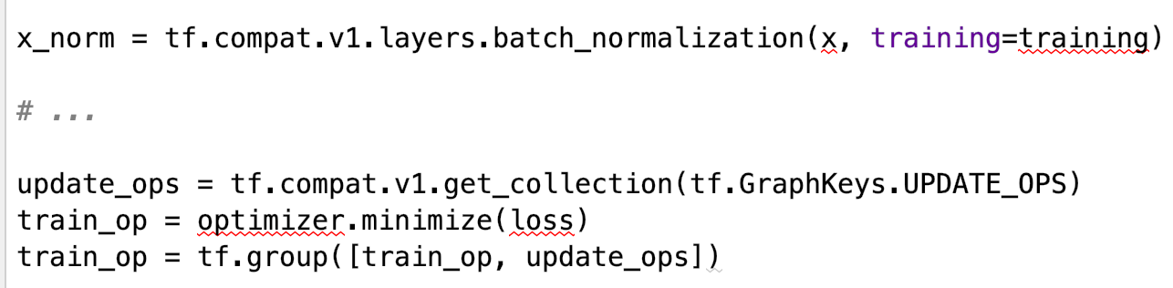
Dropout
BN

Slide 22
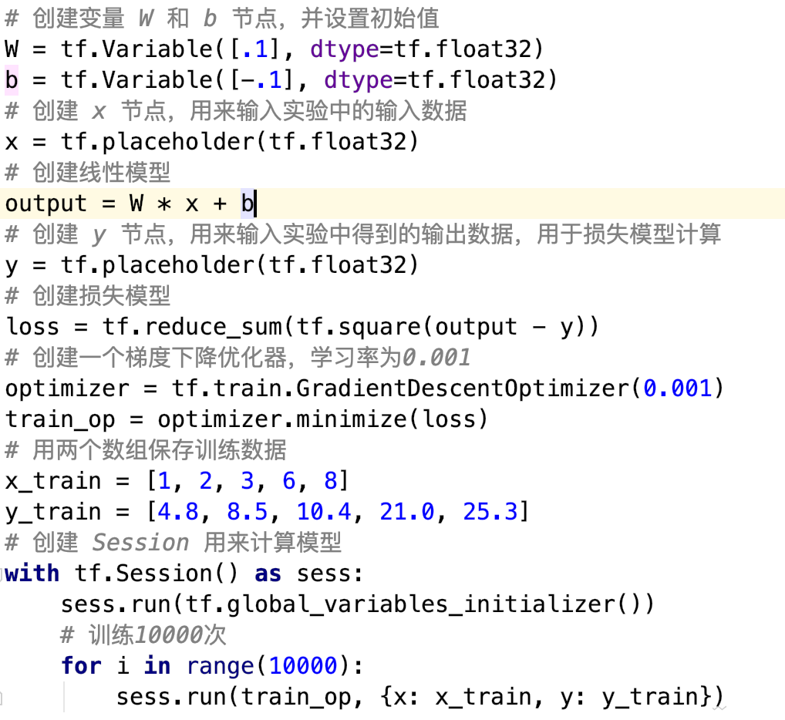
Optimization

Slide 23
Drawbacks of TF
Static Graph is hard to debug
Confused API
原因？
tf.nn.batch_normalization
tf.layers.batch_normalization
tf.contrib.layers.batch_norm
tf.keras.layers.BatchNormalization

Slide 24
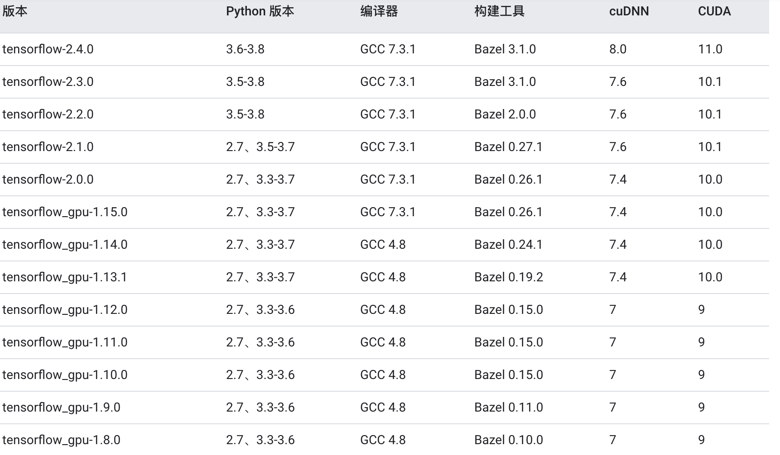
Notes:
如果cuda版本不匹配，会自动使用cpu版本的tf

Slide 25
Pytorch
2017年1月，由Facebook人工智能研究院（FAIR）基于Torch推出了PyTorch
PyTorch的前身是Torch，它是由Torch7团队开发，是一个以Python优先的深度学习框架，不仅能够实现强大的GPU加速，同时还支持动态神经网络。

Slide 26
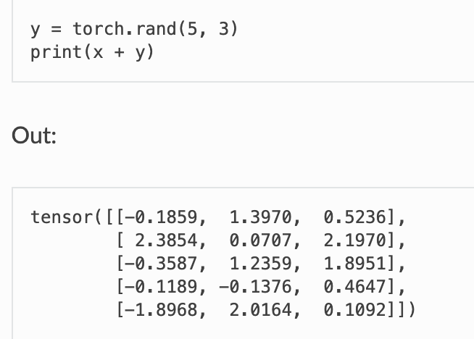
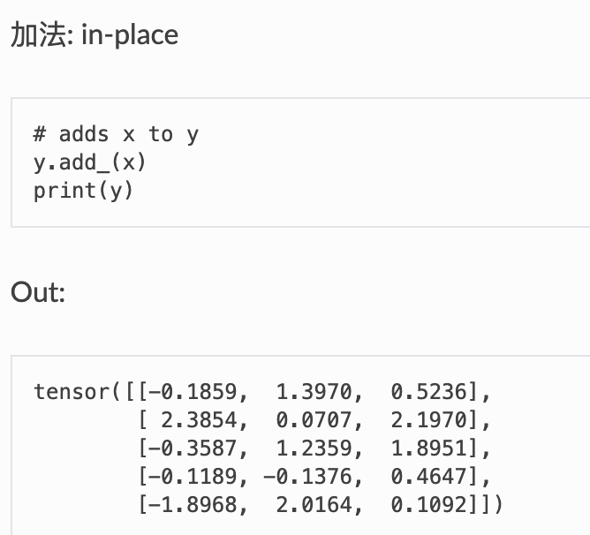
Tensors (张量)

Slide 27
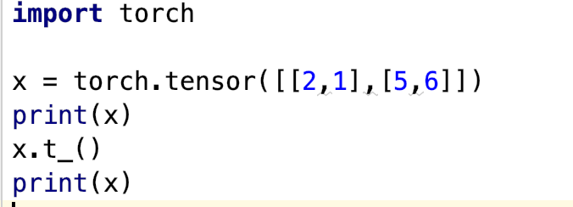
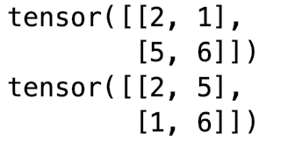
Tensor in Pytorch (inplace)
任何使张量本身发生变化的操作都有一个前缀 ‘_’
x.copy_(y)
x.t_()

Slide 28
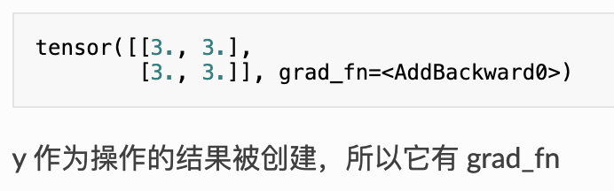
Auto grad in pytorch
tensor([[1., 1.], [1., 1.]], requires_grad=True)
y = x + 2
print(y)

Slide 29
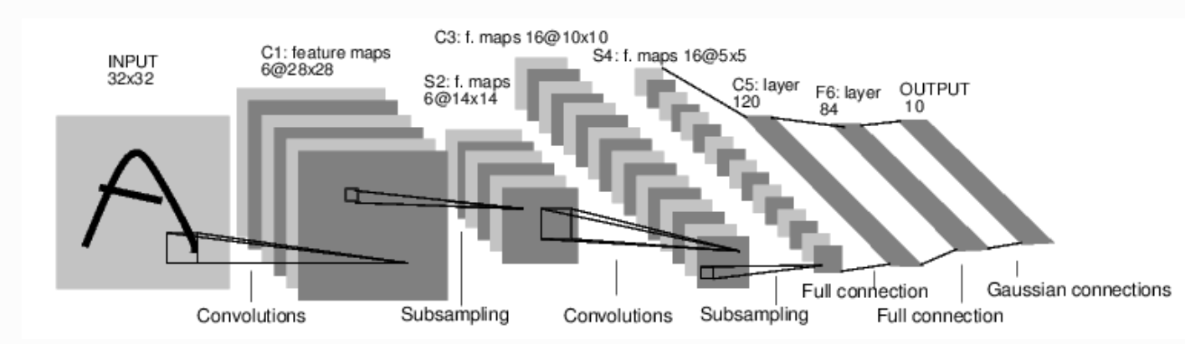
A simple CNN model in pytorch
现在对于自动梯度(autograd)有一些了解，神经网络是基于自动梯度 (autograd)来定义一些模型。一个 nn.Module 包括层和一个方法 forward(input) 它会返回输出(output)。

Slide 30
process
1.定义一个包含可训练参数的神经网络
2.迭代整个输入
3.通过神经网络处理输入
4.计算损失(loss)
5.反向传播梯度到神经网络的参数
6.更新网络的参数，典型的用一个简单的更新方法：weight = weight - learning_rate *gradient

Slide 31
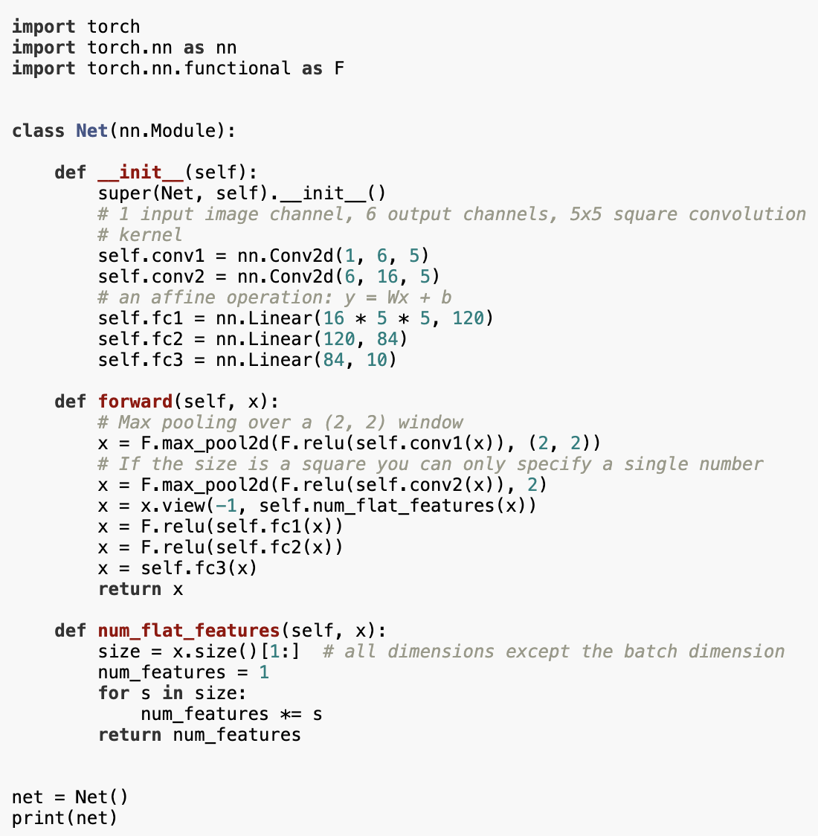
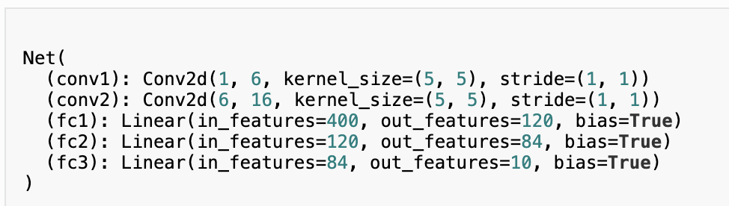
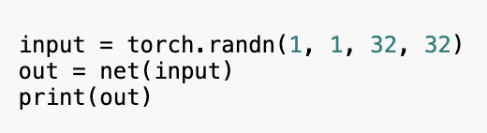

Slide 32
Difference between TF and pytorch
Tensorflow image shape [Batch, Height, Width, Channel] BHWC
Pytorch image shape [Batch, Channel, Height, Width] BCHW
Tensorflow LSTM input shape [Batch, Length, Channel]
Pytorch LSTM input shape [Length, Batch, Channel] LBC
Batch First [Length, Batch, Channel] → [Batch, Length, Channel]

Slide 33
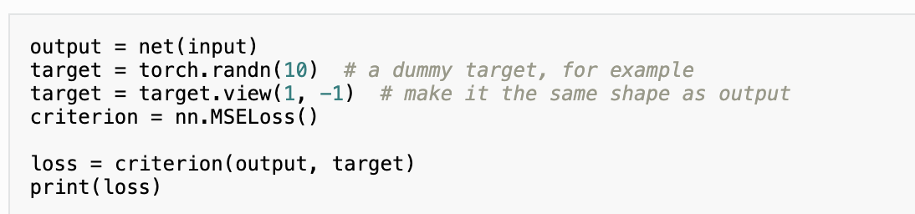
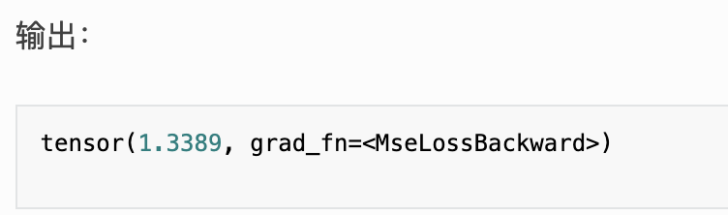

Slide 34
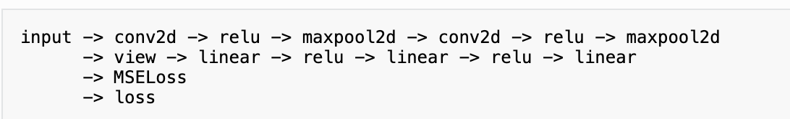
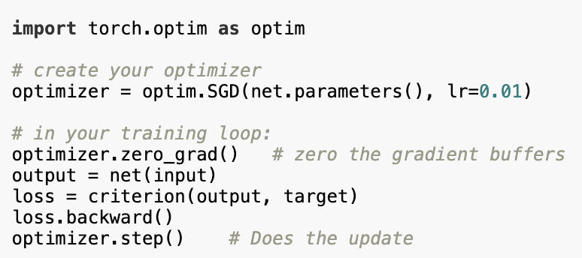
Loss Backward
如果你跟随损失到反向传播路径，可以使用它的 .grad_fn 属性，你将会看到一个这样的计算图：

Slide 35
Test in pytorch
Model.eval()
with torch.no_grad():

Slide 36
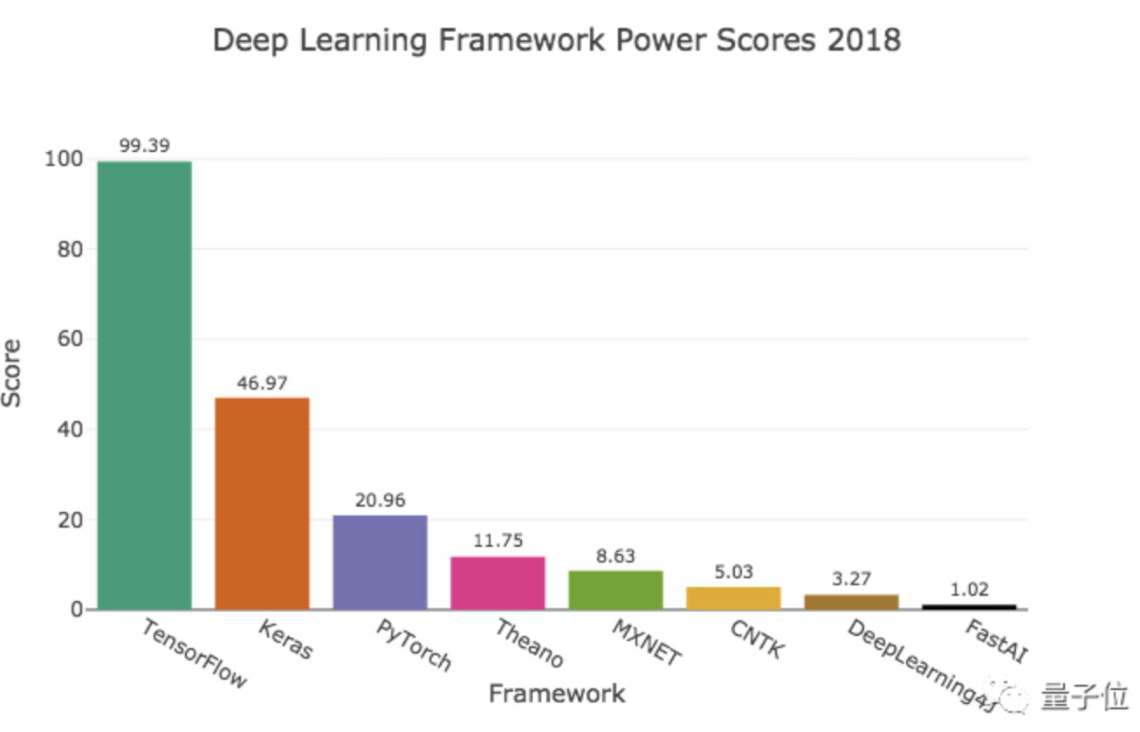
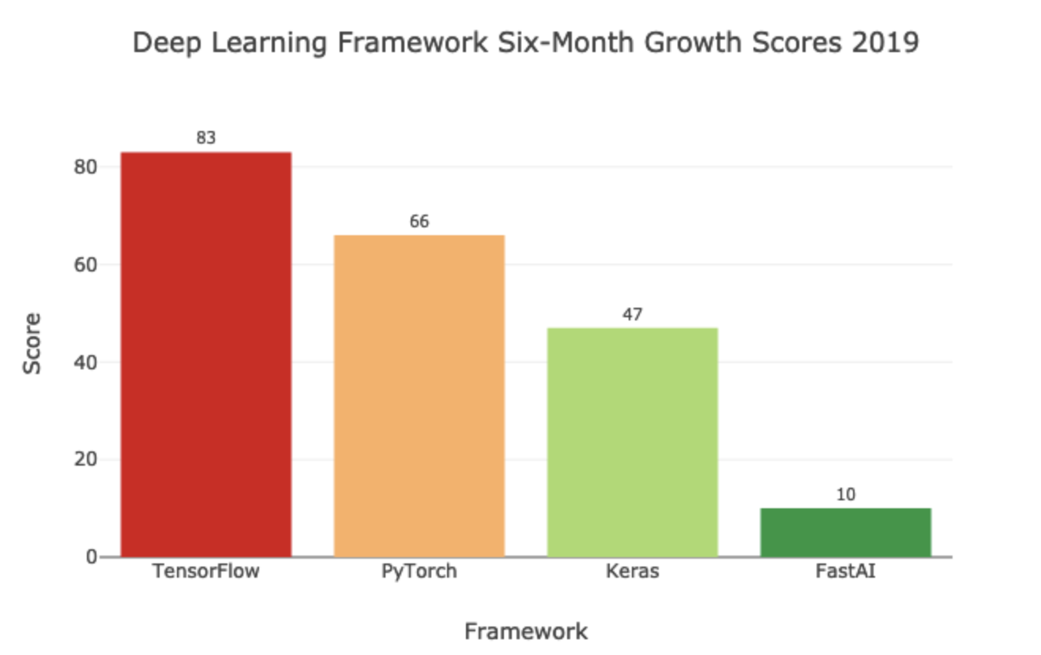
Tensorflow or Pytorch?

Slide 37
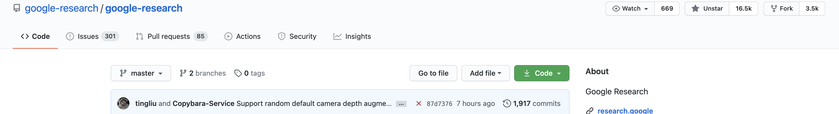
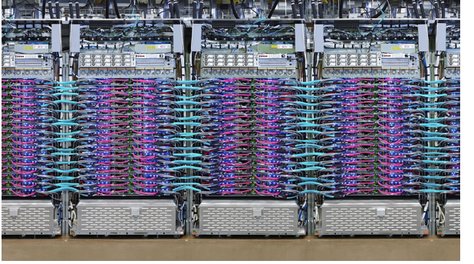
Why tensorflow?
Flexibility: from Raspberry Pi, Android, Windows, IOS, Linux to server farms
TPU server

Slide 38
Training in custom data
1. data preprocessing
2. model setting
3. optimization
4. training/evaluation
5. model saving

Slide 39

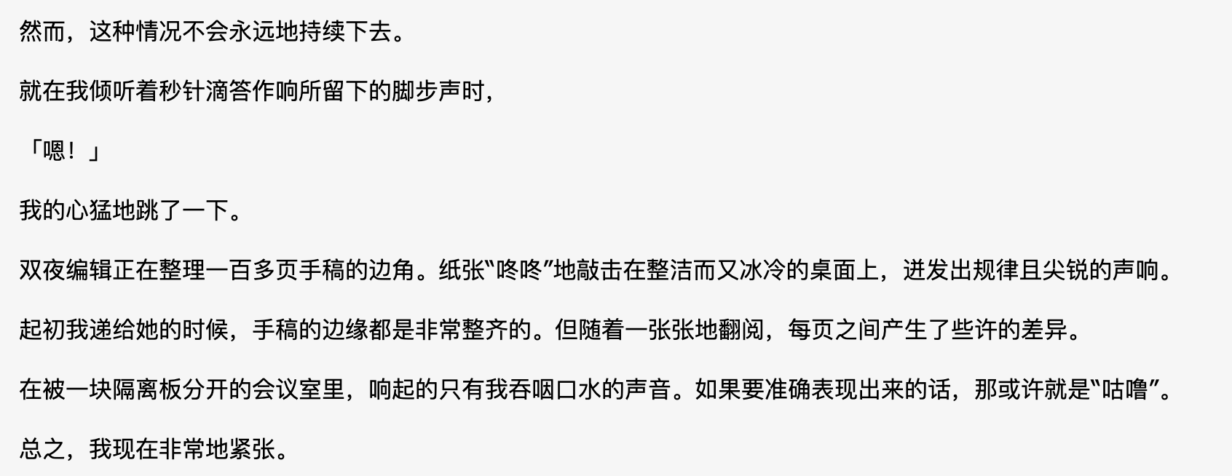
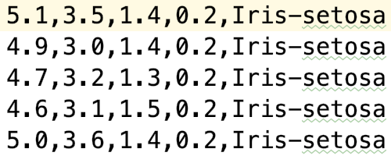
Data preprocessing
http://archive.ics.uci.edu/ml/index.php
image
Text
Feature
1. sepal length in cm 2. sepal width in cm 3. petal length in cm 4. petal width in cm 5. class: -- Iris Setosa -- Iris Versicolour -- Iris Virginica
Batch*Height*width*channel(3)
Batch*Length*1
->embedding
->Batch*Length*dim
Batch*dim

Slide 40


Image preprocess
[0,1,2,…,255]
torch.Size([3, 128, 128])
tensor([-1.0000, -0.9922, -0.9843,…, 0.9922, 1.0000])

Slide 41


Dataloader

Slide 42
Convert data and model to GPU
Model = model.cuda()
Data = data.cuda()

Slide 43

Dataloader API CIFAR10
32*32*3

Slide 44
Dataloader API CIFAR10
trainset = torchvision.datasets.CIFAR10(root='data', train=True,
download=True, transform=transform)
trainloader = torch.utils.data.DataLoader(trainset, batch_size=4,
shuffle=True, num_workers=2)

Slide 45

Model setting

Slide 46



optimization

Slide 47

SGD Optimizer.step()

Slide 48

Dynamic Learning rate
from torch.optim.lr_scheduler import LambdaLR
opt.step() sche.step()

Slide 49
Model eval
if iteration % config.eval_iters == 0: model.eval() total_scores = [] with torch.no_grad(): for items in val_loader: data, label = items['data'].cuda(), items['label'] prediction = model(data) prediction = prediction.cpu().numpy() label = label.numpy() score = metric(prediction, label) total_scores.append(score) print(np.mean(total_scores))

Slide 50
Model saving
def save(save_path): torch.save({'iteration': iteration, 'model': model.state_dict(), 'opt': opt.state_dict()}, save_path)
def load(model, opt, save_path): if torch.cuda.is_available(): data = torch.load(save_path) else: data = torch.load(save_path, map_location=lambda storage, loc: storage) model.load_state_dict(data['model']) opt.load_state_dict(data['opt']) iteration = data['iteration'] return model, opt, iteration

Slide 51
Tensorflow saving
tf.train.MonitoredTrainingSession(checkpoint_dir=ckpt, hooks=training_hooks, config=config)
global_step = tf.train.get_or_create_global_step()

Slide 52


Model Zoo
Pytorch CV
NLP transformers
https://github.com/huggingface/transformers

Slide 53

Tensorflow zoo
tf.keras.applications

Slide 54
Loss functions in DNN
LinearRegression
LogisticRegression
SVM

Slide 55

LinearRegression

Slide 56

LogisticRegression

Slide 57

SVM

